Slide 1
“People start to heal the moment they feel heard.”
-CHERYL RICHARDSON

Slide 2
C O N T E N T S
01
02
03
04
05
06
About the Counseling Cell
What is Counseling
Goals and Roles
Our journey so far..
The road ahead..
Students’ feedback

Slide 3
COUNSELING CELL

Slide 4
Counselling cell provides a safe and a secured environment for the staff (teaching or non-teaching) and students alike. It offers a non-judgmental and an empathetic space for anyone who is seeking help and support
It aims to spread awareness on the benefit and importance of psychological wellbeing and seek help and support. Counselling services are for anyone experiencing psychological distress due to reasons like anxiety, depression, loss, trauma, relationship conflicts, confusions and crisis around identity and life transitions, academic stress, social anxiety etc., or for anyone who is not able to seek professional help due to financial constraints.

Slide 5
The Counseling Cell of Vivekananda College was initially a part of the ‘Health and Wellness Committee’ of the college.
It was established as an independent entity in the year 2019.
Ms. Mala Vohra Khanna has been the College Counselor since the introduction of Counseling services in the college.
The Counseling Cell was actively involved in helping students and providing them with the necessary support and services even during the Covid period.

Slide 6
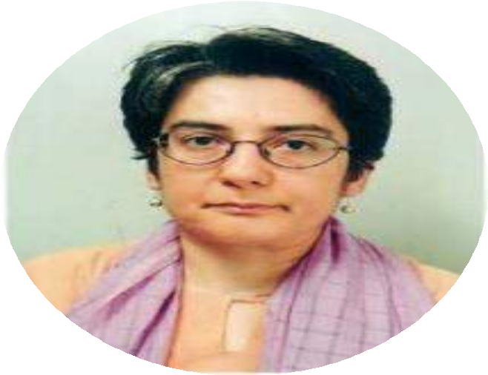
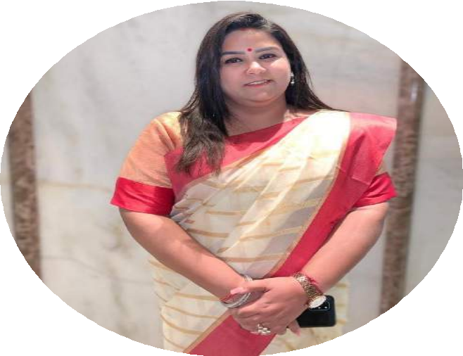
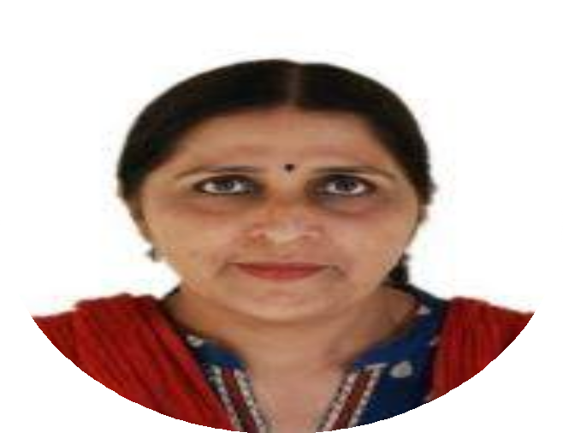
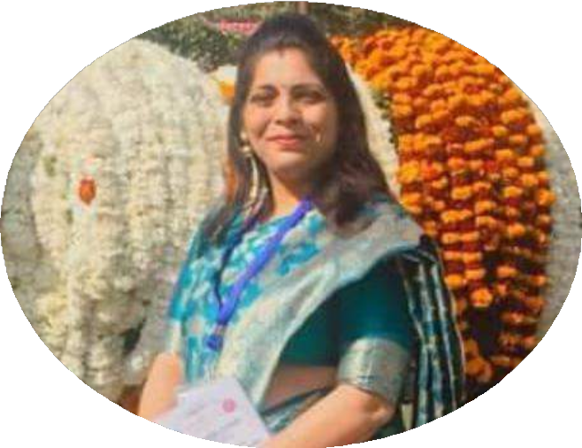
Prof. Salma Seth
CONVENOR
Ms. Mala Vohra Khanna
COUNSELOR & CLINICAL PSYCHOLOGIST
Dr. Arpana Beniwal
MEMBER
Dr. Kamini Taneja
MEMBER

Slide 7
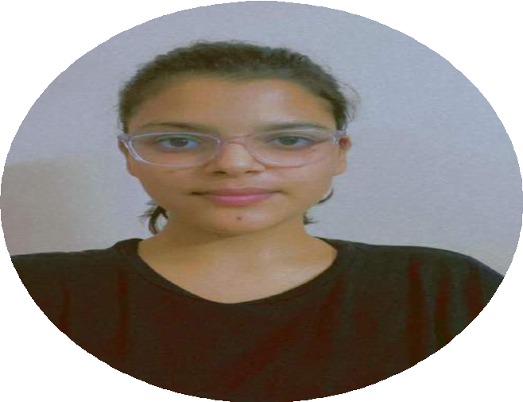
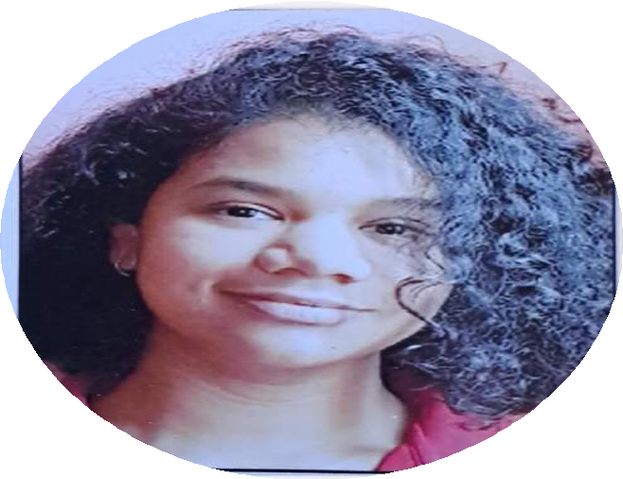
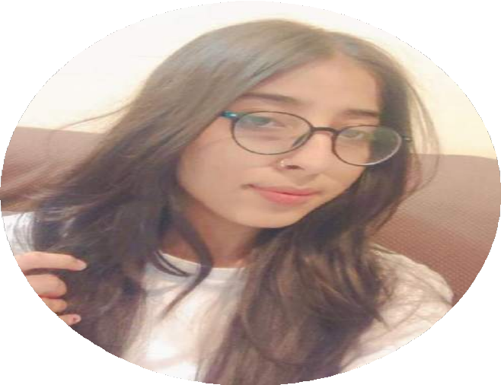
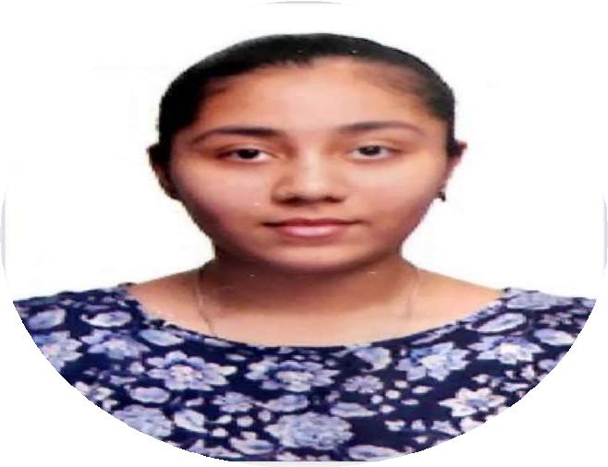
Yashika Chauhan
STUDENT COORDINATOR
Shivina Mathur
STUDENT VOLUNTEER
Amisha
STUDENT VOLUNTEER
Kritika Gulati
STUDENT VOLUNTEER

Slide 8
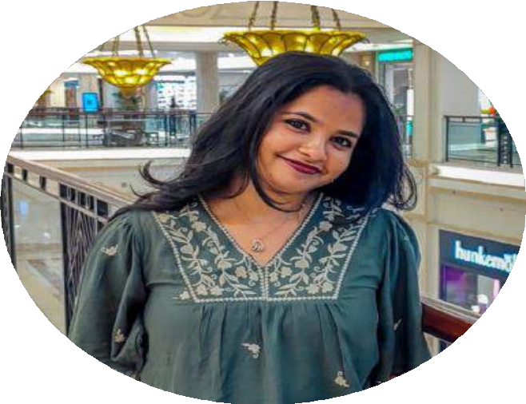
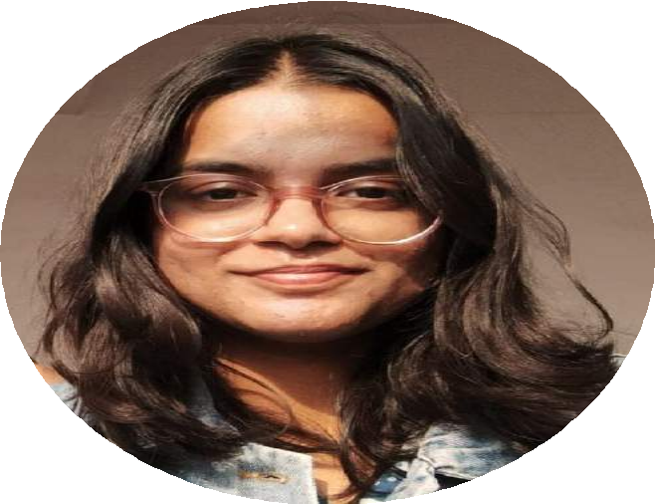
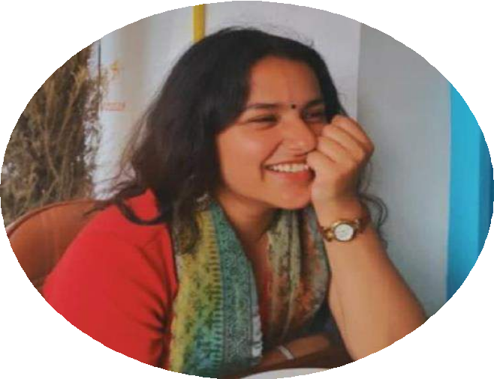
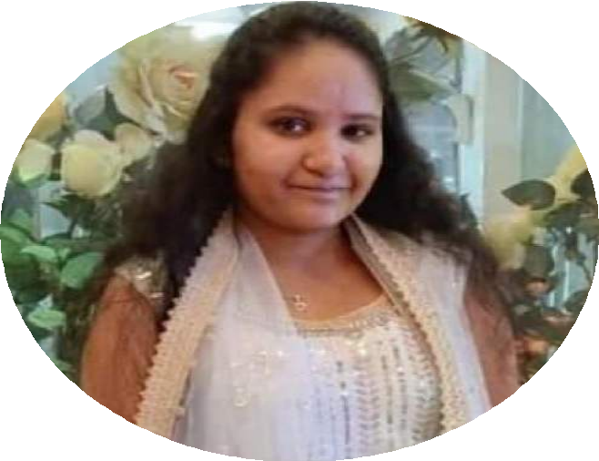
Nandini Majumdar
STUDENT VOLUNTEER
Varnika
STUDENT VOLUNTEER
Hemayushi Gupta
STUDENT VOLUNTEER
Khushi Singhal
STUDENT VOLUNTEER

Slide 9
“In my early professional years, I was asking the question: How can I treat, or cure, or change this person? Now I would phrase the question in this way: How can I provide a relationship which this person may use for his own personal growth?” -Carl Rogers

Slide 10
WHAT IT IS
NOT
WHAT IT IS
Therapeutic in nature Counseling provides a safe and non-judgmental space for emotional and psychological growth | Befriending Counseling is not similar to speaking to a friend or a closed one and merely talking about your problems
Helping clients to know themselves better Counseling can help clients to explore and understand who they really are | Advising or providing solutions Counseling does not include giving advice or solutions to the client’s problems
Providing therapy Counselors are professionals who are well- trained and equipped with psychological theories and techniques to help and support clients | Mentoring Mentoring involved a relationship between a mentor and mentee where a mentee seeks help from an expert for personal or professional issues
A field with trained professionals with relevant education Counselors are trained professionals who hold educational degrees in the relevant field | A listening platform Counseling is much more than just actively listening to the clients’ concerns

Slide 13
Goals and Roles
E
To help students to overcome different problems such as anxiety, and emotional distress
C
To provide a safe space for the students to talk freely
B
To create awareness about mental health and provide one-on- one counseling sessions
D
To guide them to overcome emotional and psychological issues
A
To provide aid to students to help them resolve their personal issues

Slide 15
Self-love
06th March 2019
The sessions covered understanding self-love, cultivating self-compassion, identifying self-love blocks, setting boundaries and prioritizing self-care, practicing gratitude and positive affirmations, letting go of perfectionism, embracing self-acceptance, building resilience, and goal setting.
The workshop aimed to empower individuals to continue their journey of self-love and personal growth beyond the workshop.

Slide 16
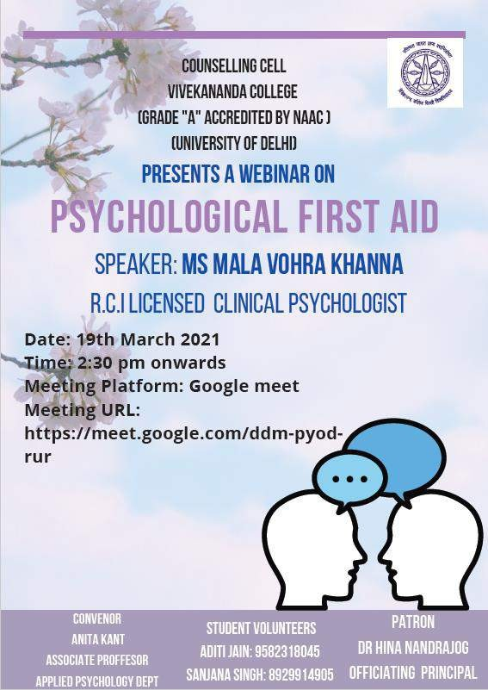
Psychological First Aid
19th march 2021
The Counseling Cell of Vivekananda College organized a workshop on trauma.
The speaker provided an introduction to the topic
and discussed the physical, emotional, and psychological responses that can occur after experiencing a traumatic event.
Ms. Khanna explained the underlying reasons behind these responses and their effects on individuals

Slide 17
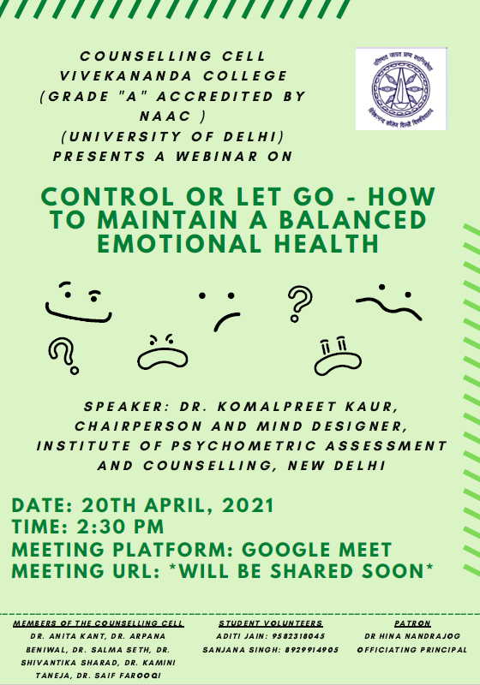
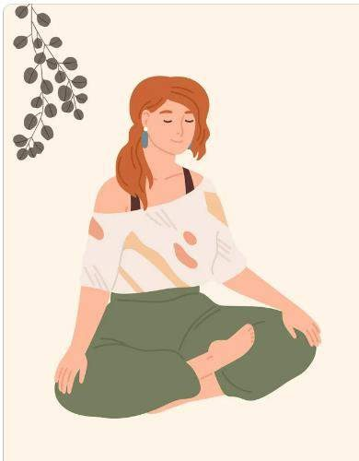
Control or Let go- How to maintain a balanced emotional health
20th April 2021
The Counseling Cell of Vivekananda College organized a webinar on maintaining emotional health.
The speaker, Dr. Komalpreet Kaur, Chairperson and
Mind Designer at the Institute of Psychometric Assessment and Counseling in New Delhi, discussed key elements for maintaining emotional balance and strategies for letting go of stress and anxiety.
Attendees gained important insights on how to cultivate a healthy emotional state.

Slide 18
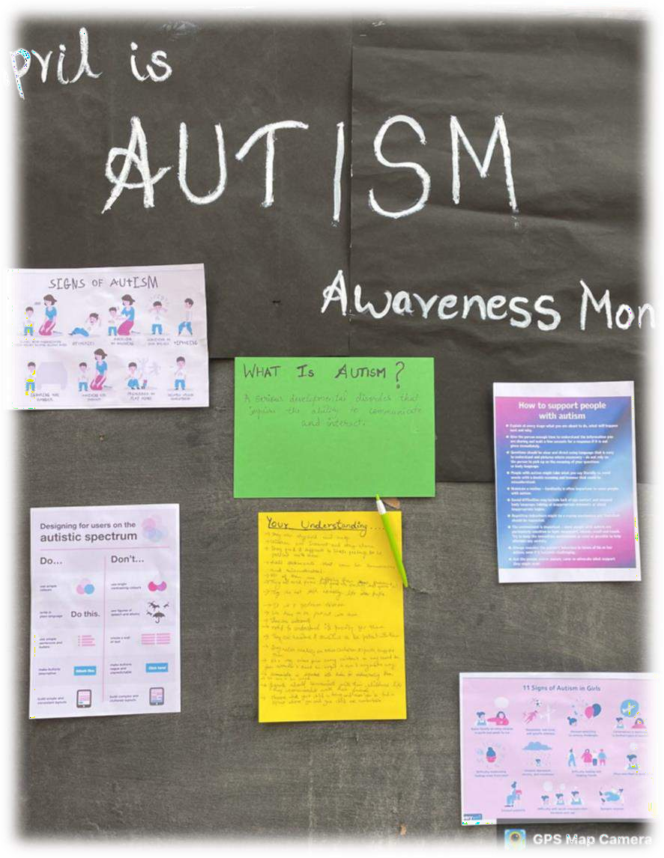
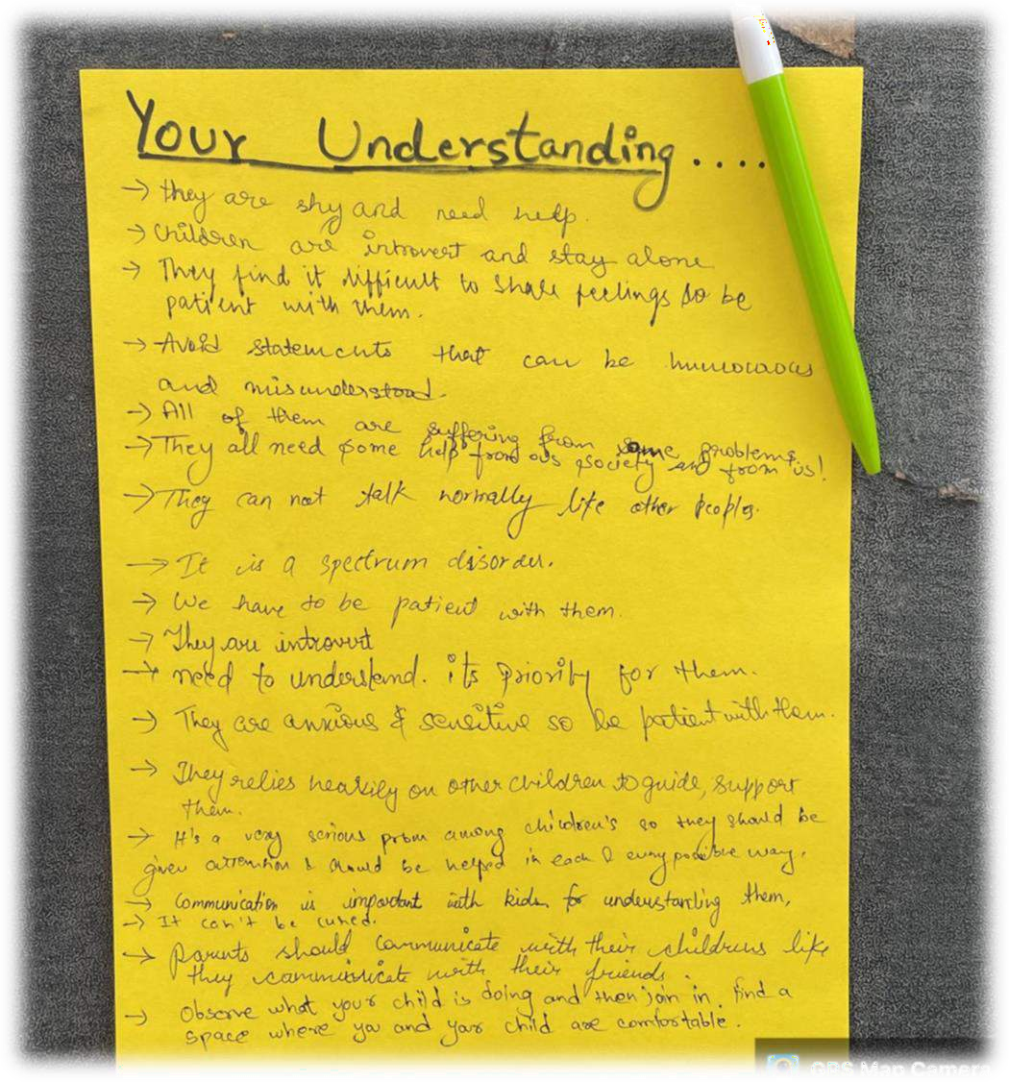
A board was kept in front of the Sharda Hall which had 4 posters of autism containing signs, how to support, do's and don'ts. Students were asked to write about their own understanding of the posters. For example, one student wrote that it is a serious disorder, children should be given much attention. Another student wrote that autistic kids are anxious.

Slide 19
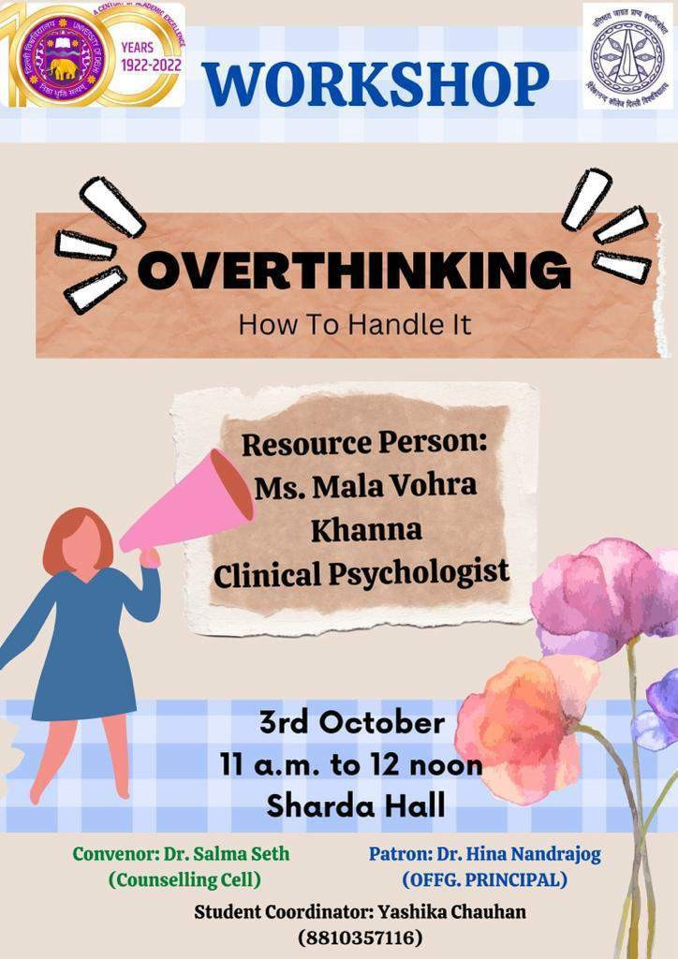
OVERTHINKING
3rd October 2022
The workshop introduced the audience to the meaning of overthinking and the negative impact it can have on one’s life.
The speaker talked about different ways of coping with it and managing it everyday life.
The workshop also demonstrated the importance of living in the present.
It also provided the audience resources in the form of techniques to deal with overthinking.

Slide 20
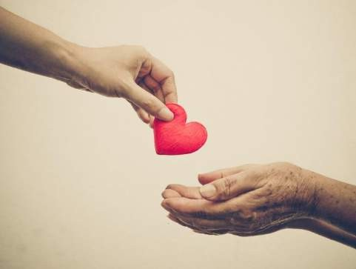
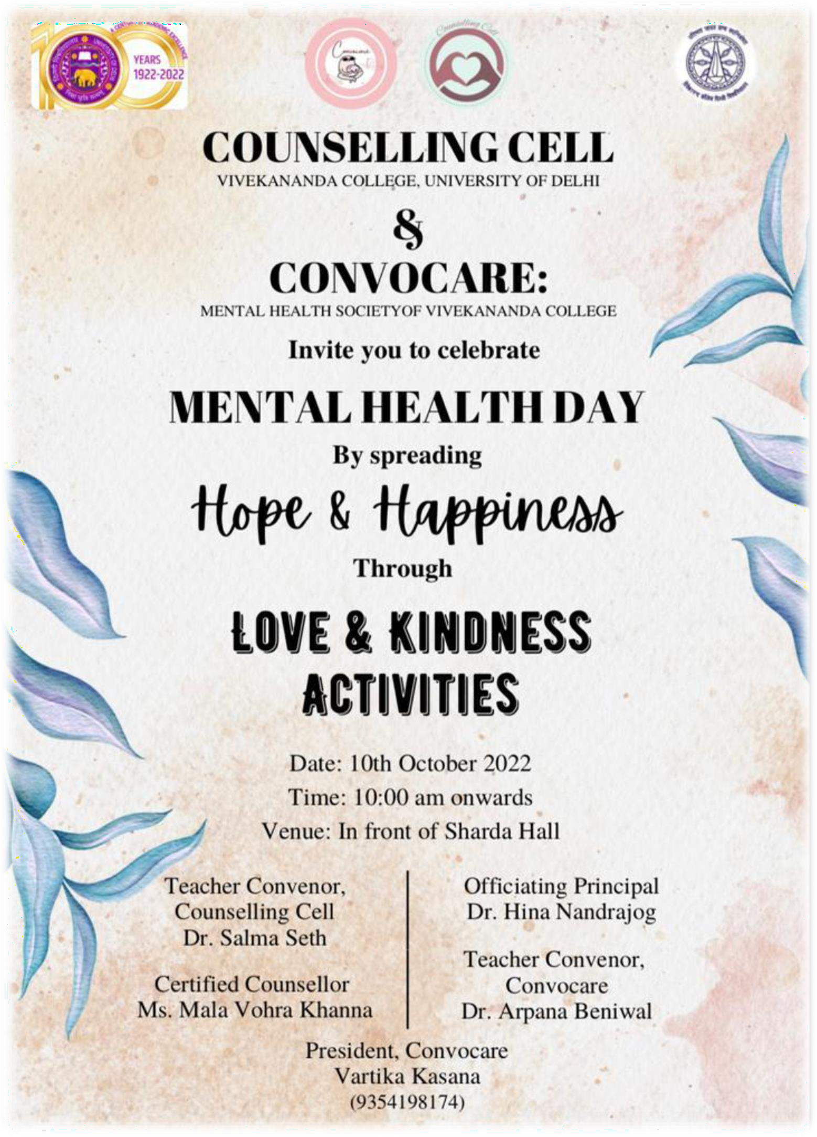
Celebrating Mental Health Day
with
Love & Kindness
Activities
10th October 2022
The activity included a “TREE OF KINDNESS” wherein, on the branches of the tree, the students were asked to write down on sticky notes the acts of kindness that they did.
In correspondence, there was another board with the roots of the tree which contained different ‘dares’ that the students had to perform.
As a token of gratitude and appreciation for their participation, the students were given chocolates.

Slide 21
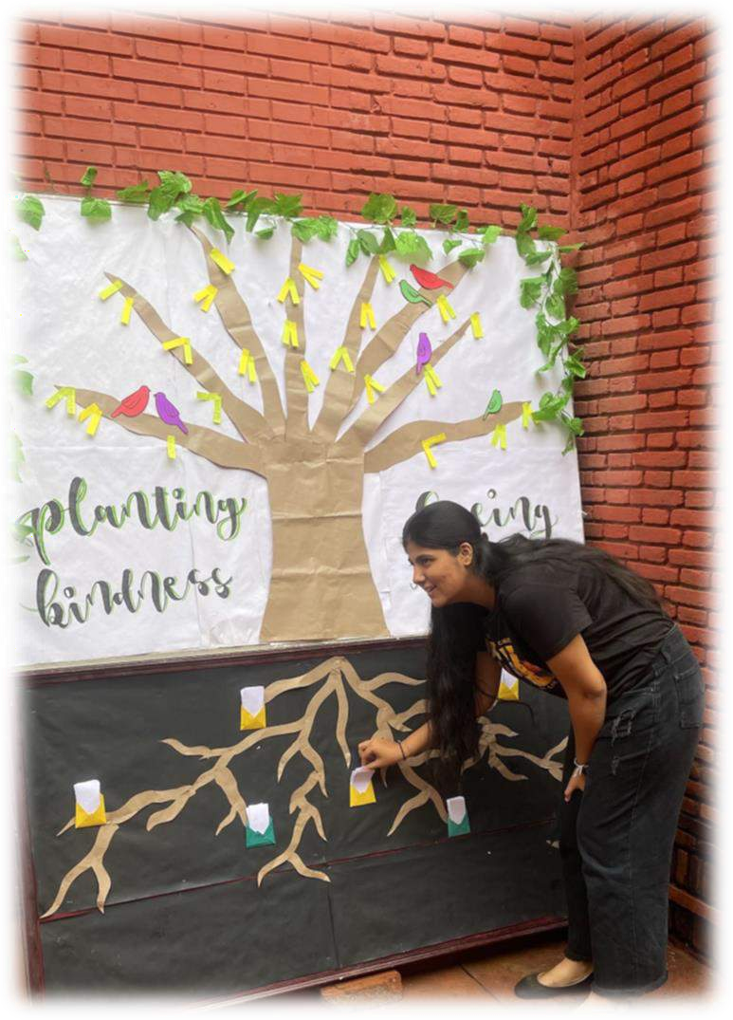
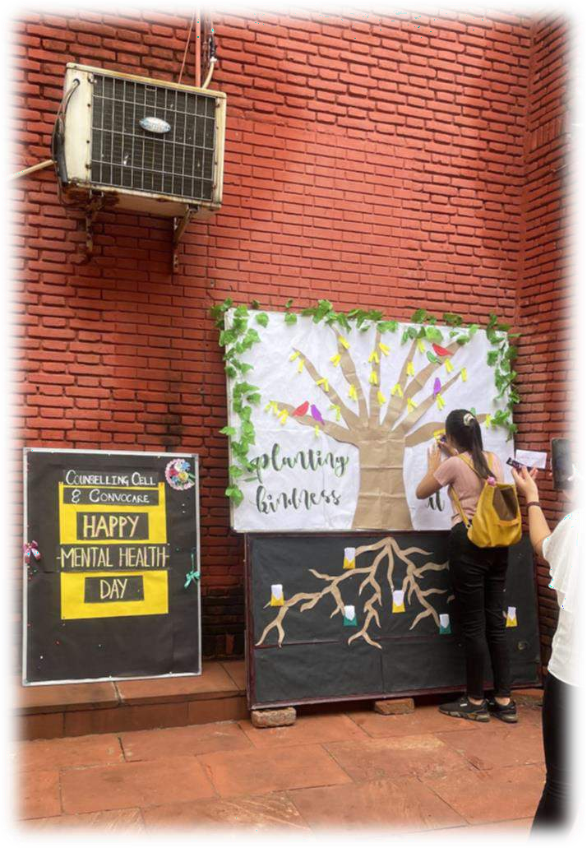
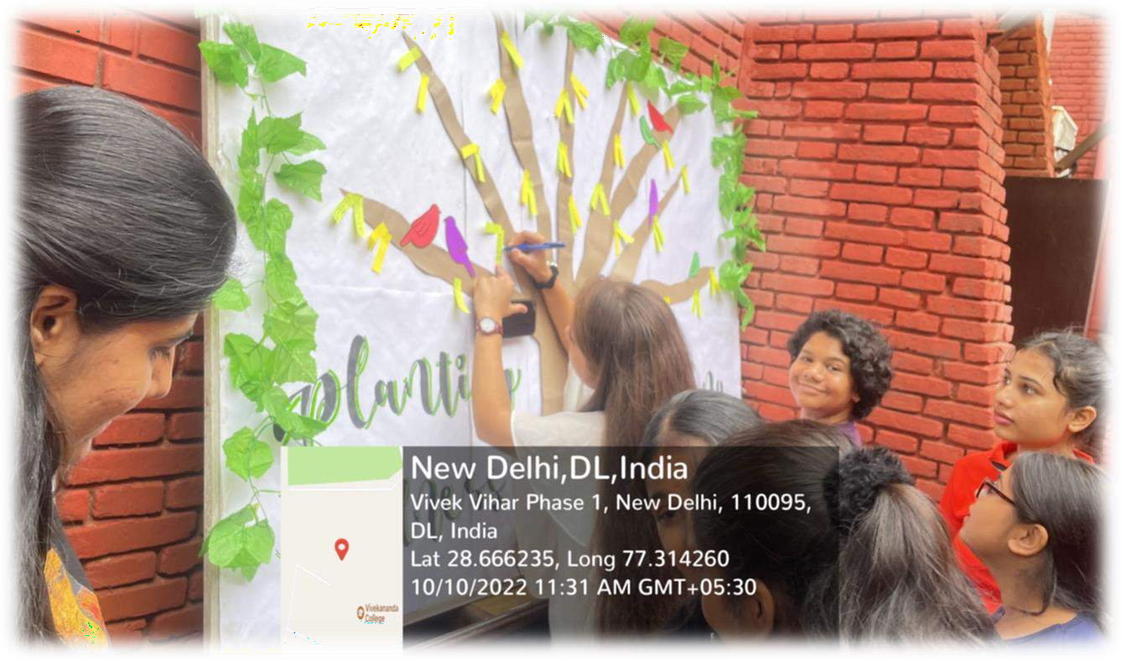
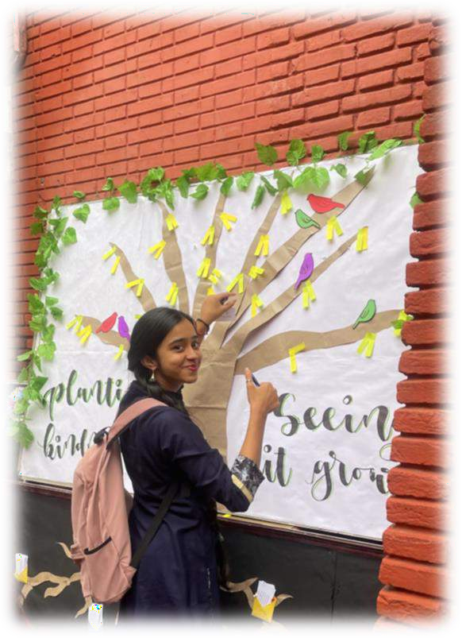

Slide 22
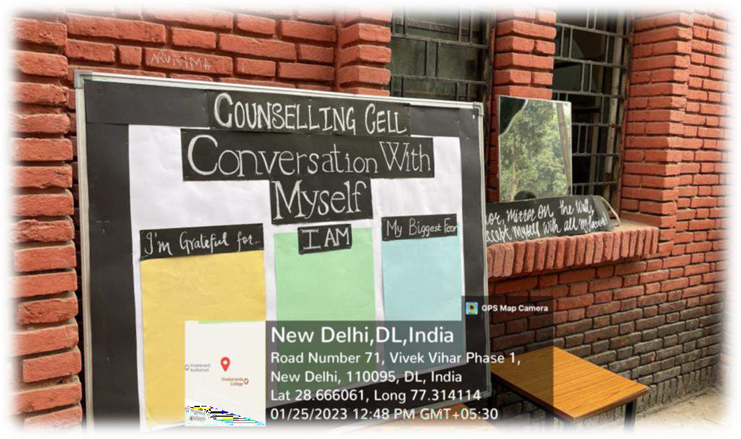
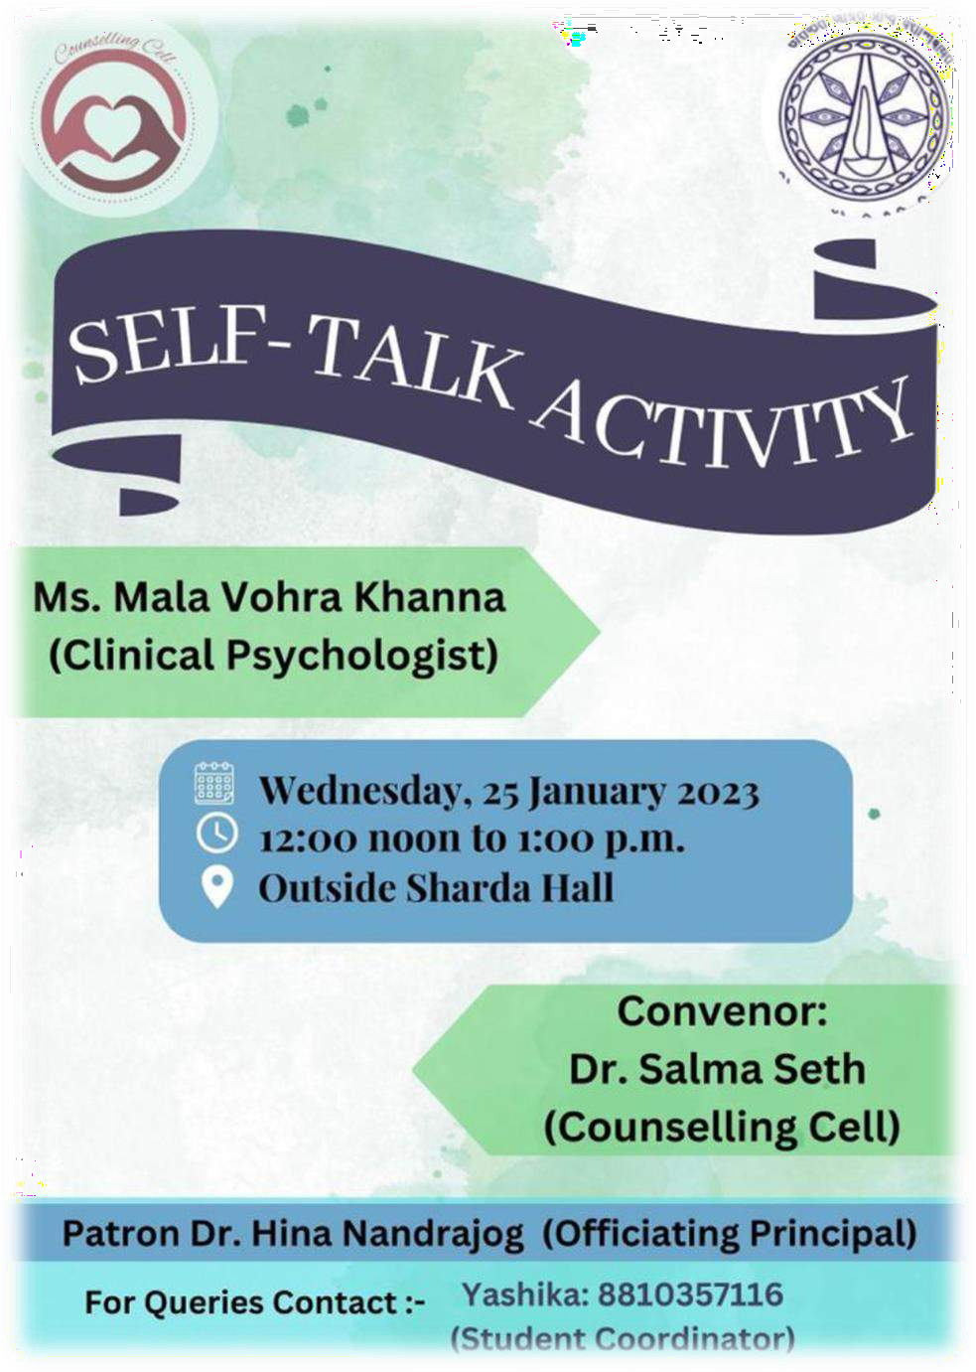
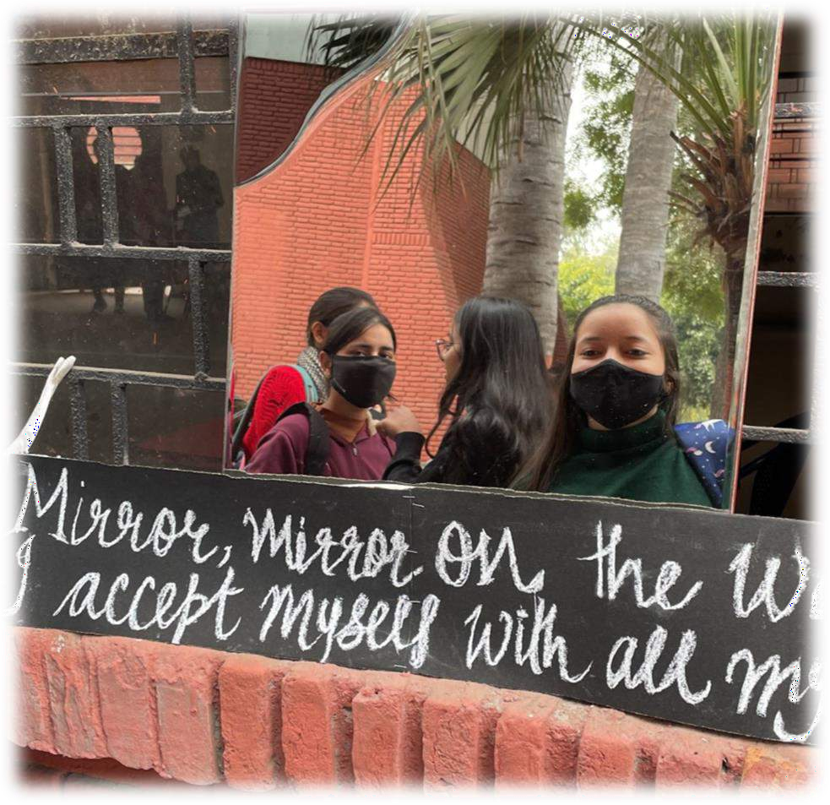
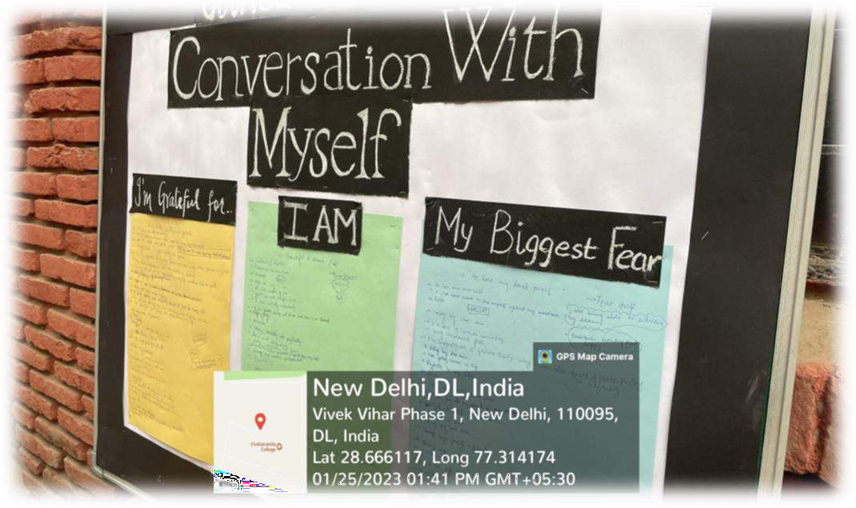
25th January 2023
In this activity, a mirror was placed against the wall and a board displaying three sections, viz., “I am”, “I am grateful for”, and “My biggest fear” was kept besides it.
The students were first asked to look in the mirror that read “Mirror mirror on the wall, I accept all my FLAWS” and then were instructed to fill the three sections on the board.
This was done to make them ‘see themselves’ for who
they are.
Activity

Slide 24
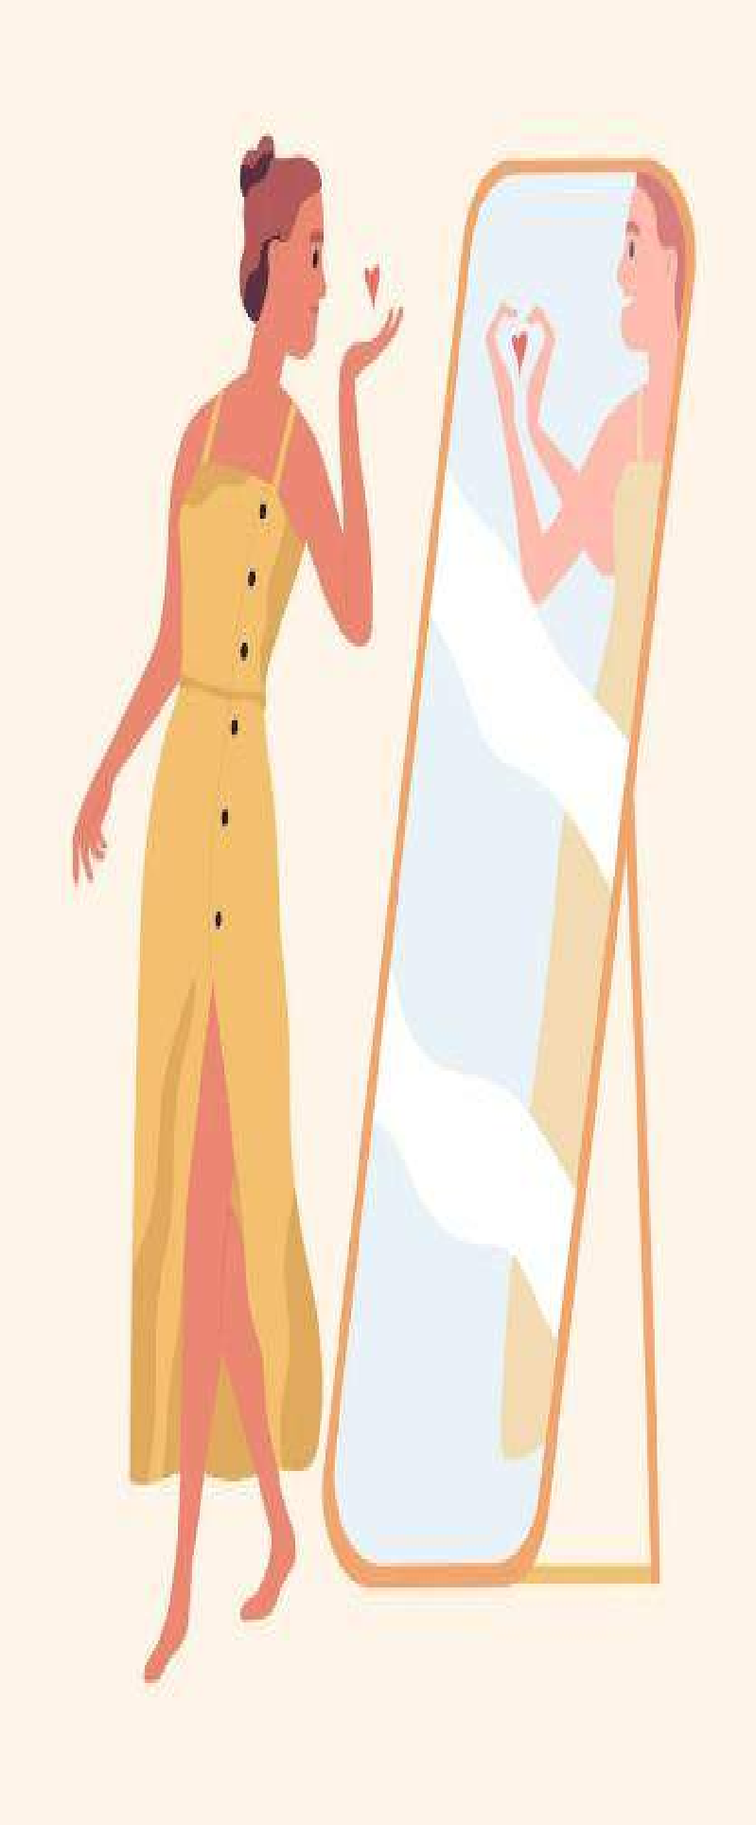
For this activity, a bulletin board was placed against the wall displaying 4 sections that had 4 major domains of self- care:-
13th February 2023
Physical, Emotional, Social, and Spiritual.
Students were encouraged to write as many self-care methods as they would like.
S e l f - c a r e

Slide 25
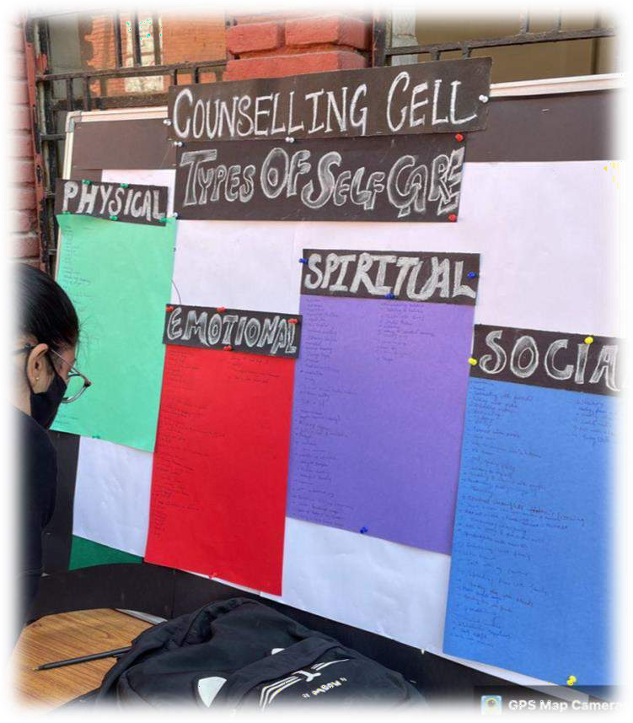
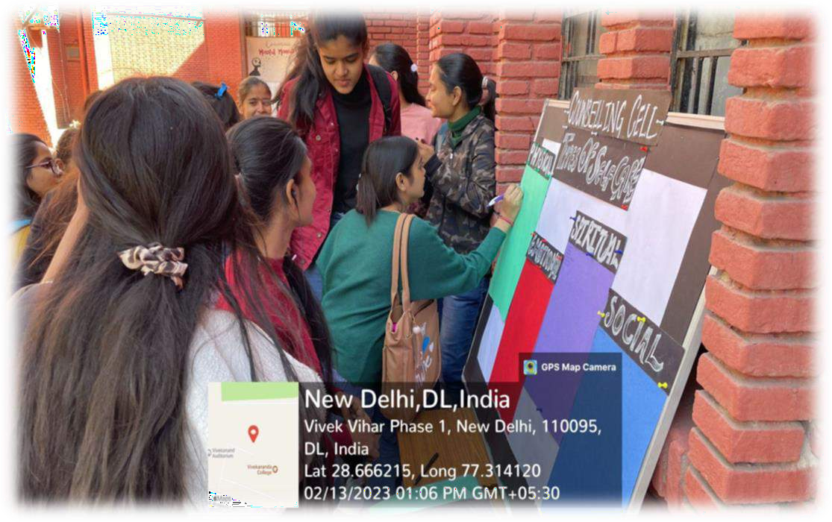

Slide 26
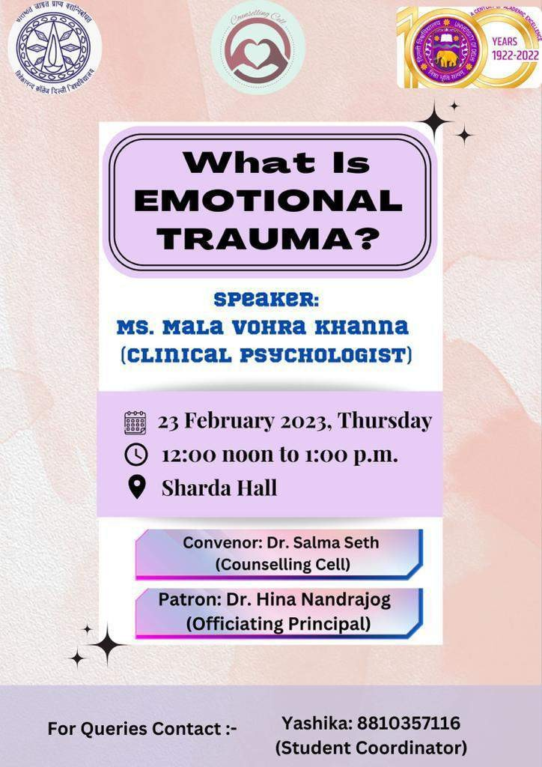
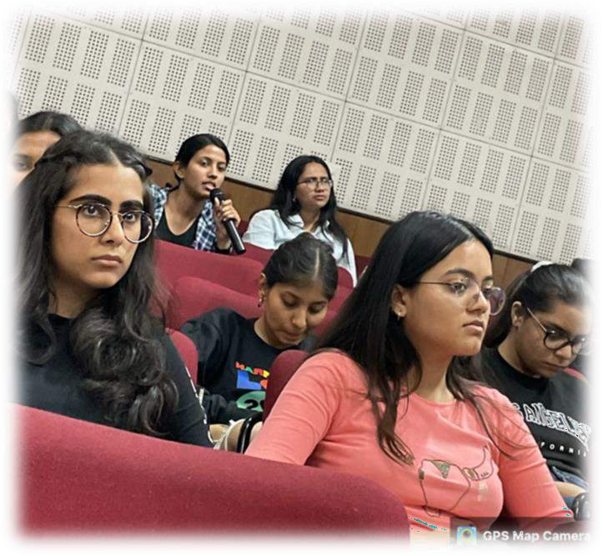
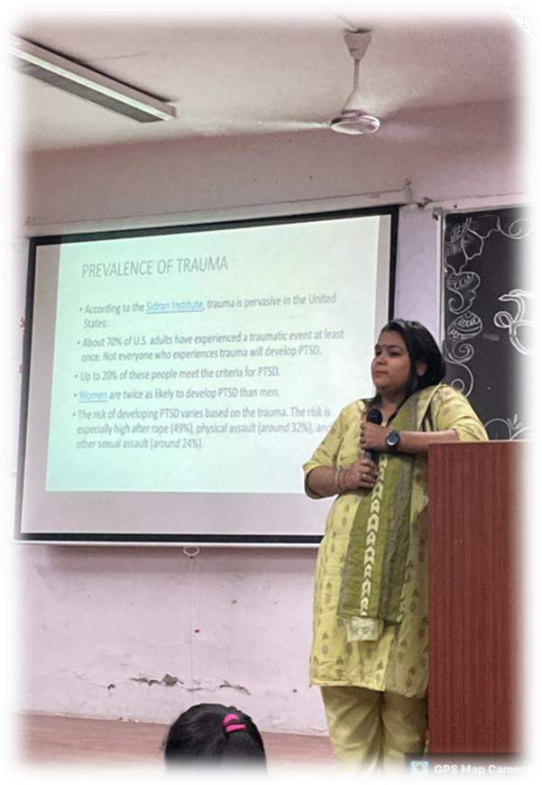
Emotional Trauma
23rd February 2023
The workshop was conducted to teach students the meaning of trauma, how to identify trauma, and how to cope with it in a heathy way.
The workshop provided
information on the different types of trauma, about PTSD, its treatment, and so on.
One of the main agendas of the
workshop was to extend a helping to those who might be going through the same.

Slide 27
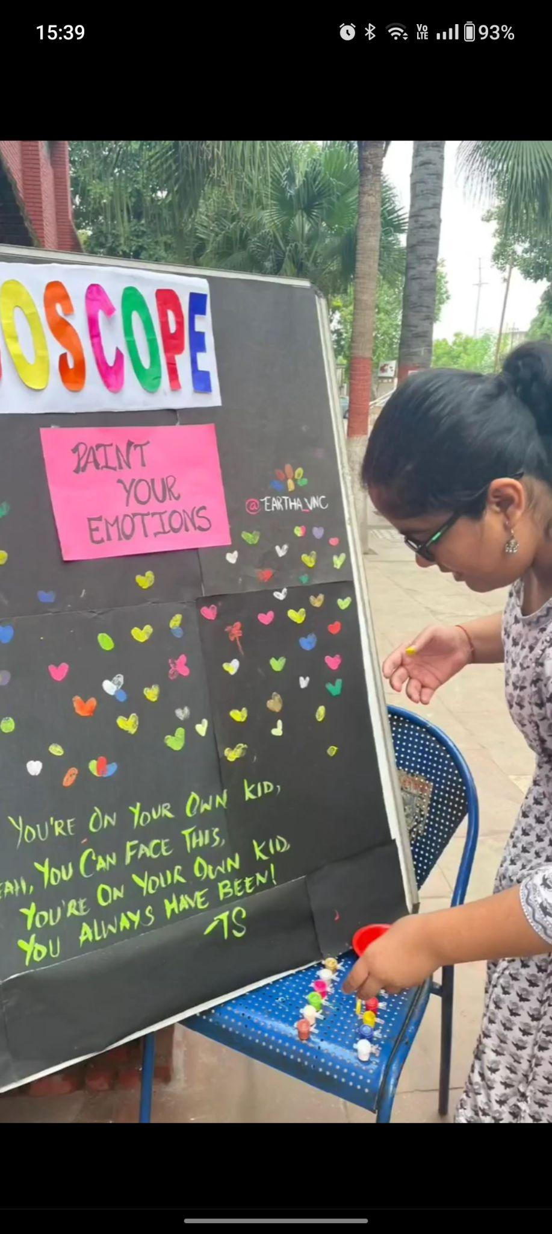
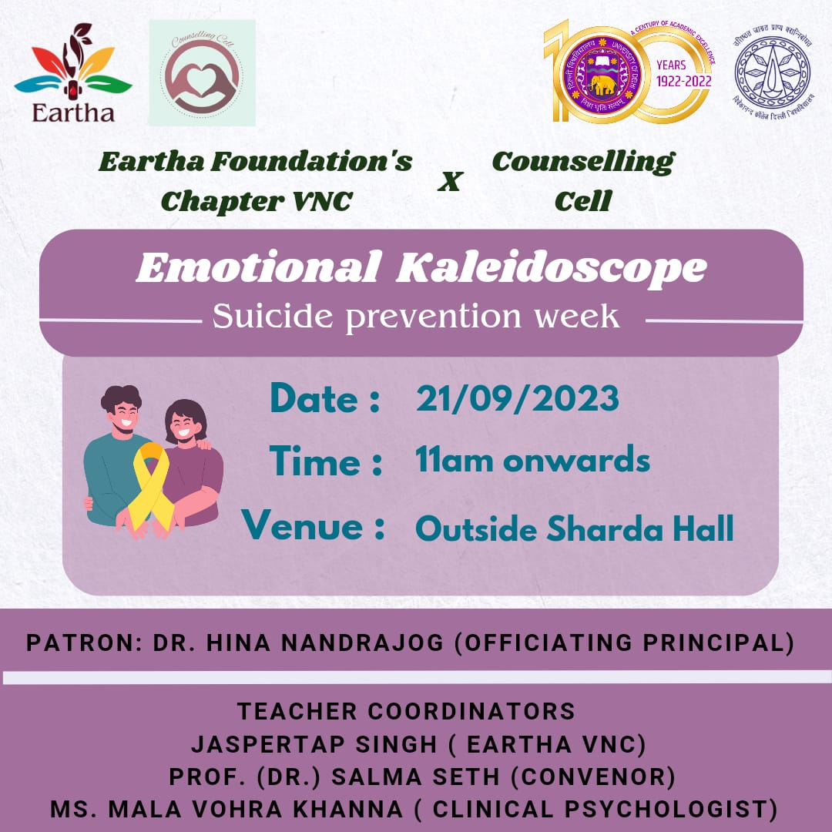
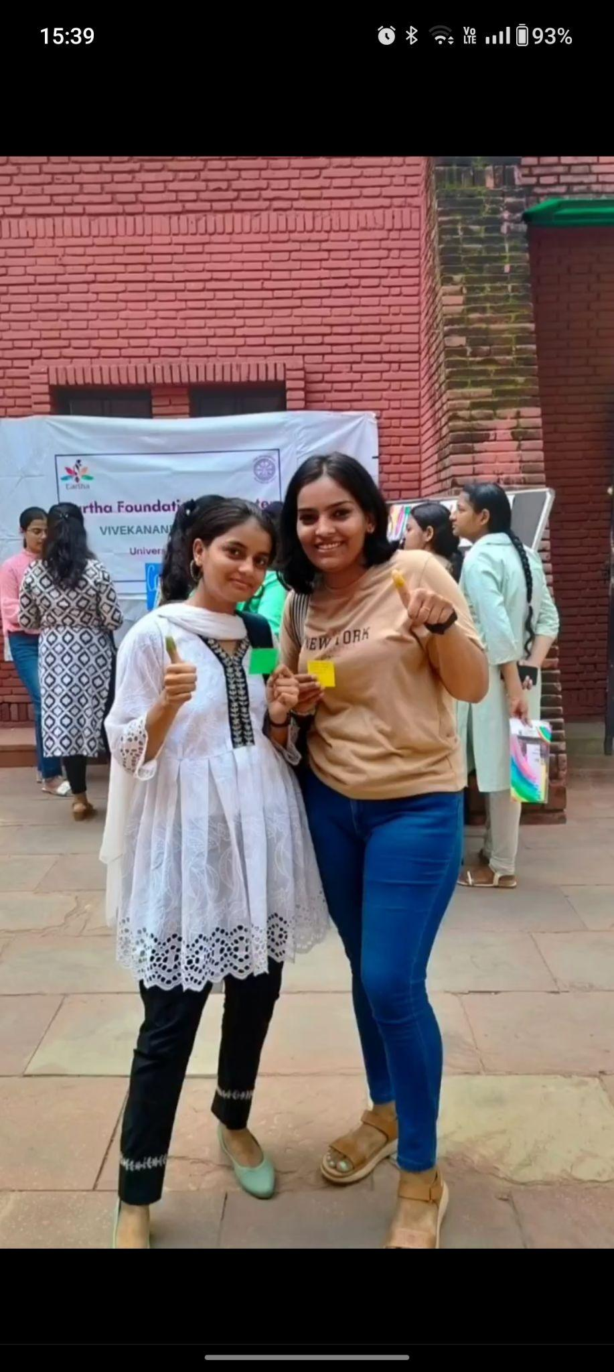
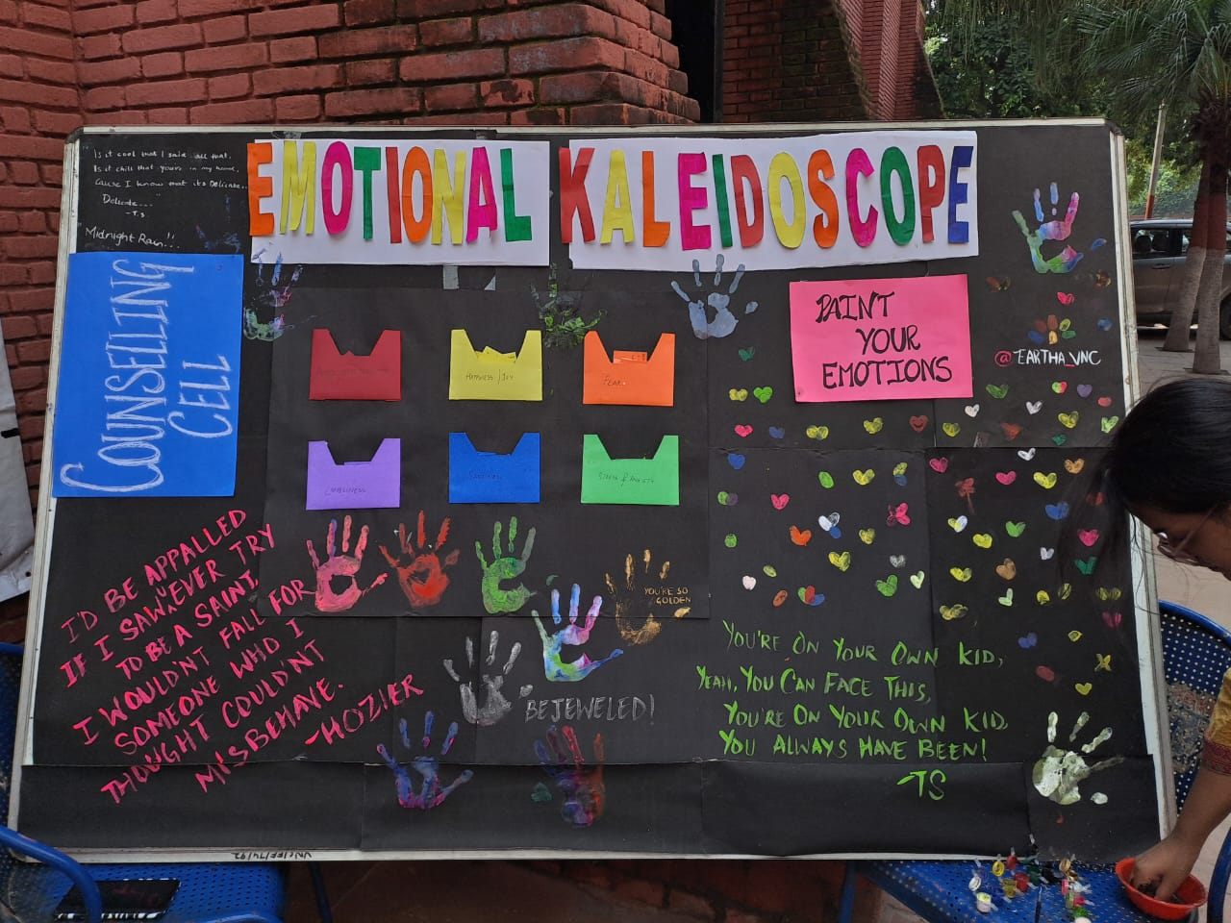
EMOTIONAL
KALEIDOSCOPE
21st September 2023
i
In collaboration with Eatha Foundation, VNC, this activity was conducted for Suicide prevention week.
our emotions are a myriad of colours and patterns, and building upon this, this activity utilized colours as a medium of recognizing and expressing emotions.
the students were also provided with small messages to help navigate the emotions.

Slide 28
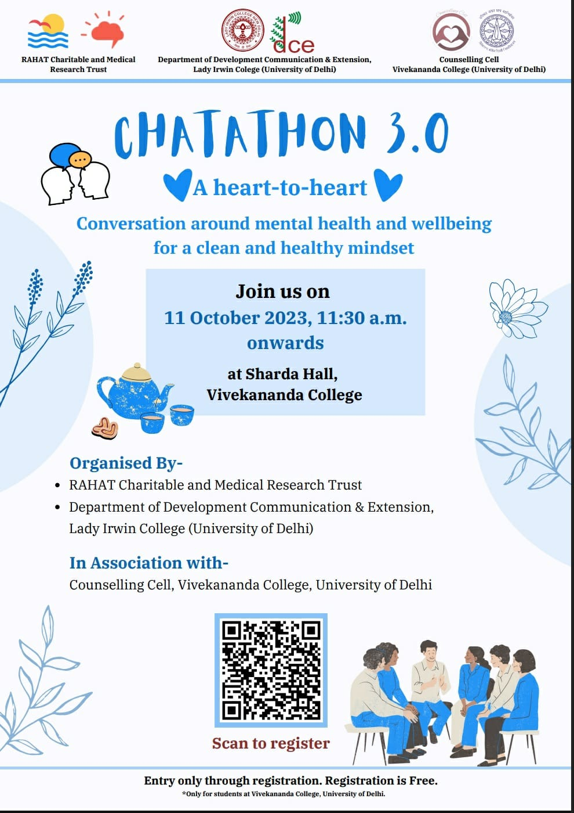
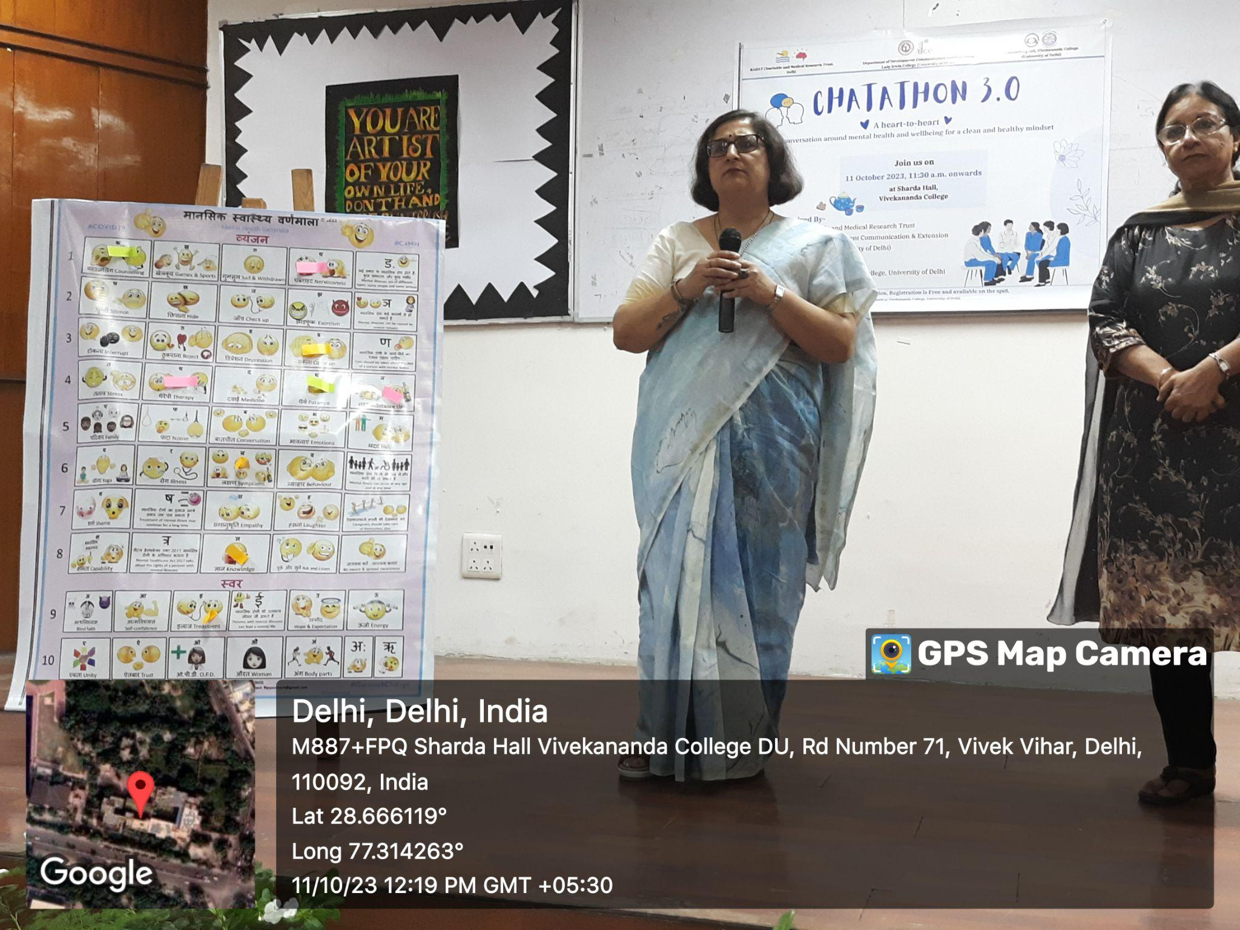
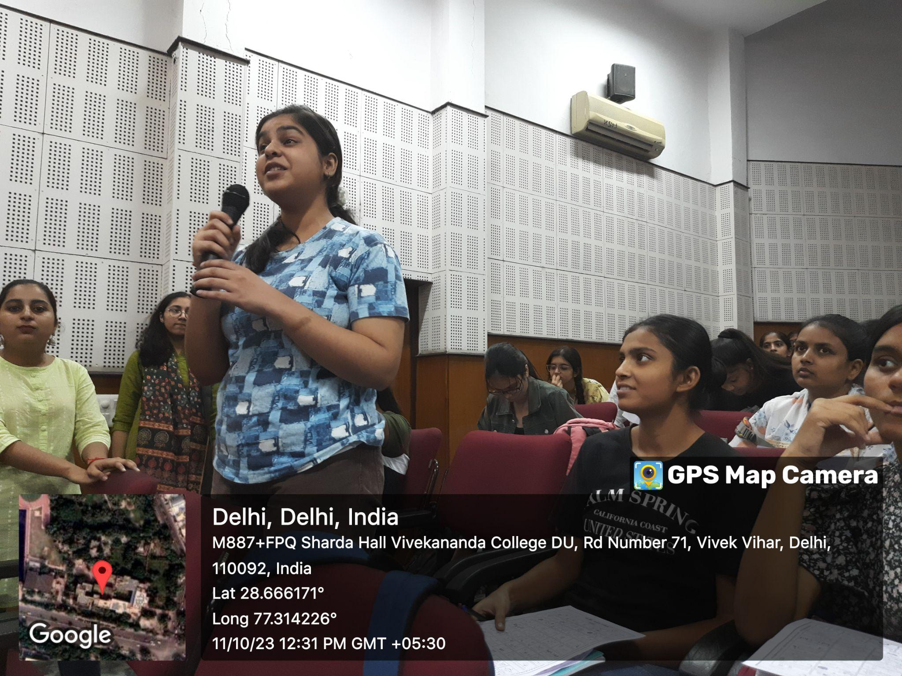
CHATATHON 3.0
Conversation around Mental Health and Wellbeing
11th october 2023
In collaboration with RAHAT Charitable & Medical Research Trust., this immersive workshop was conducted with the goal of raising awareness about mental health issues and creating a safe space where students can openly discuss their challenges and worries.
CHATATHON 3.0 was an expert-led open conversation where students can freely express themselves and engage in mindful discussions.

Slide 29
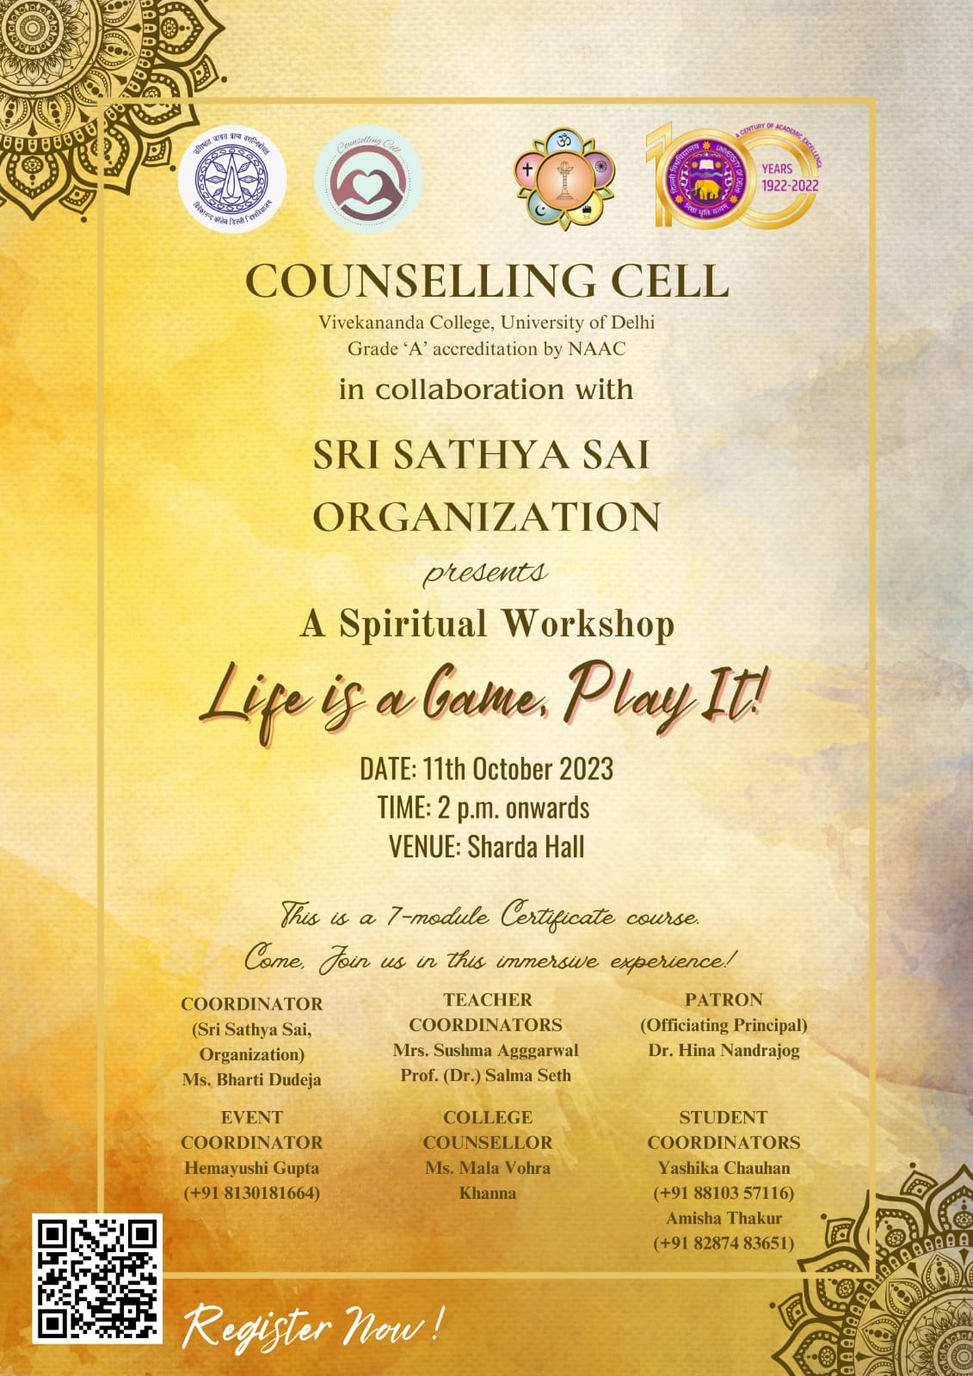
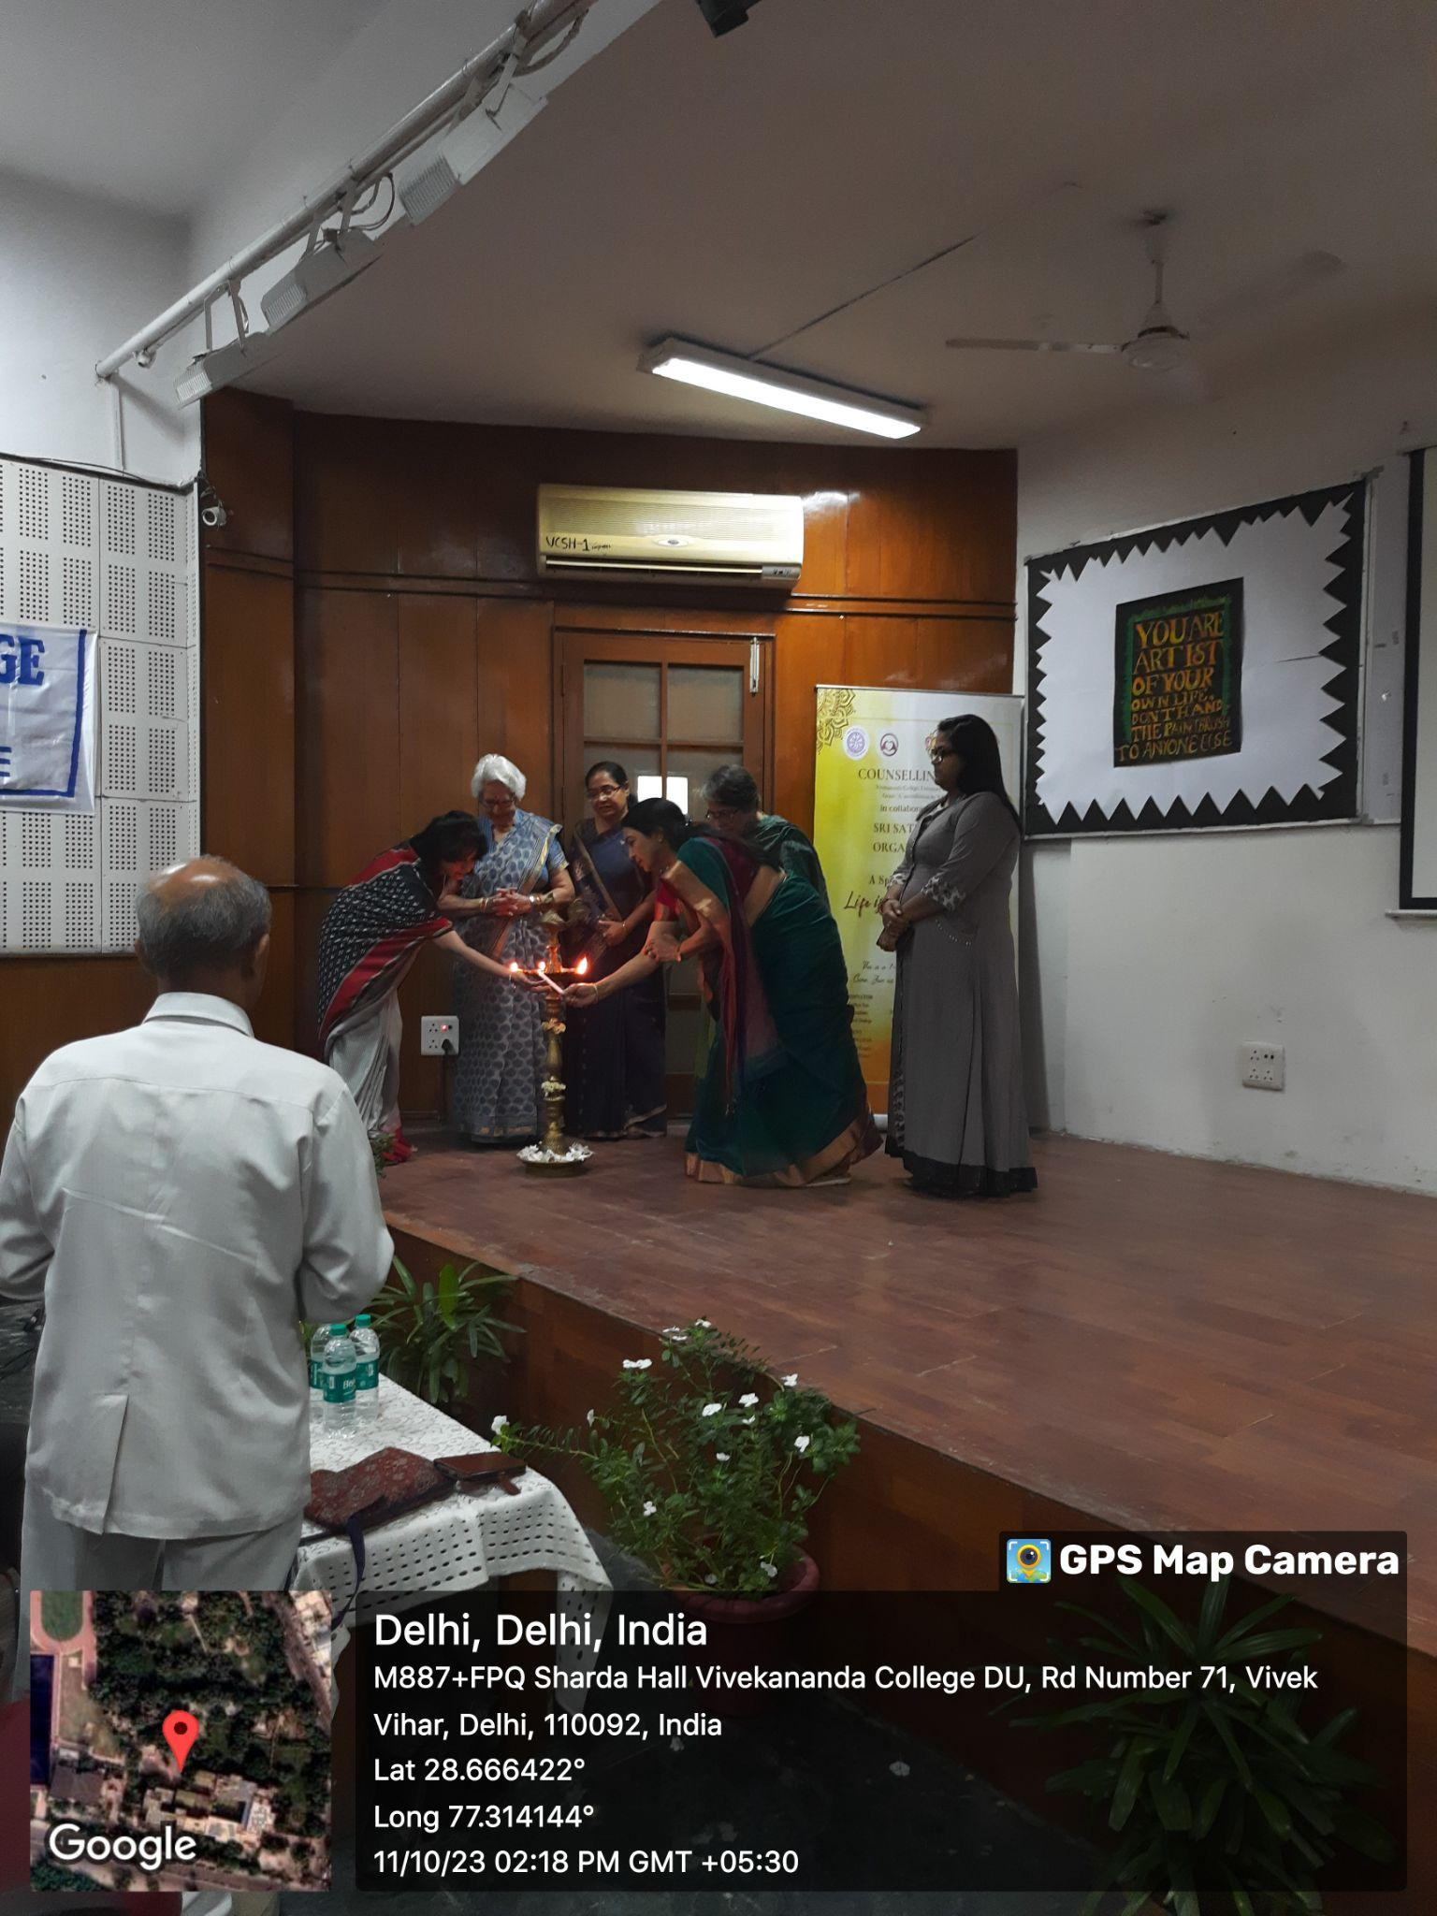
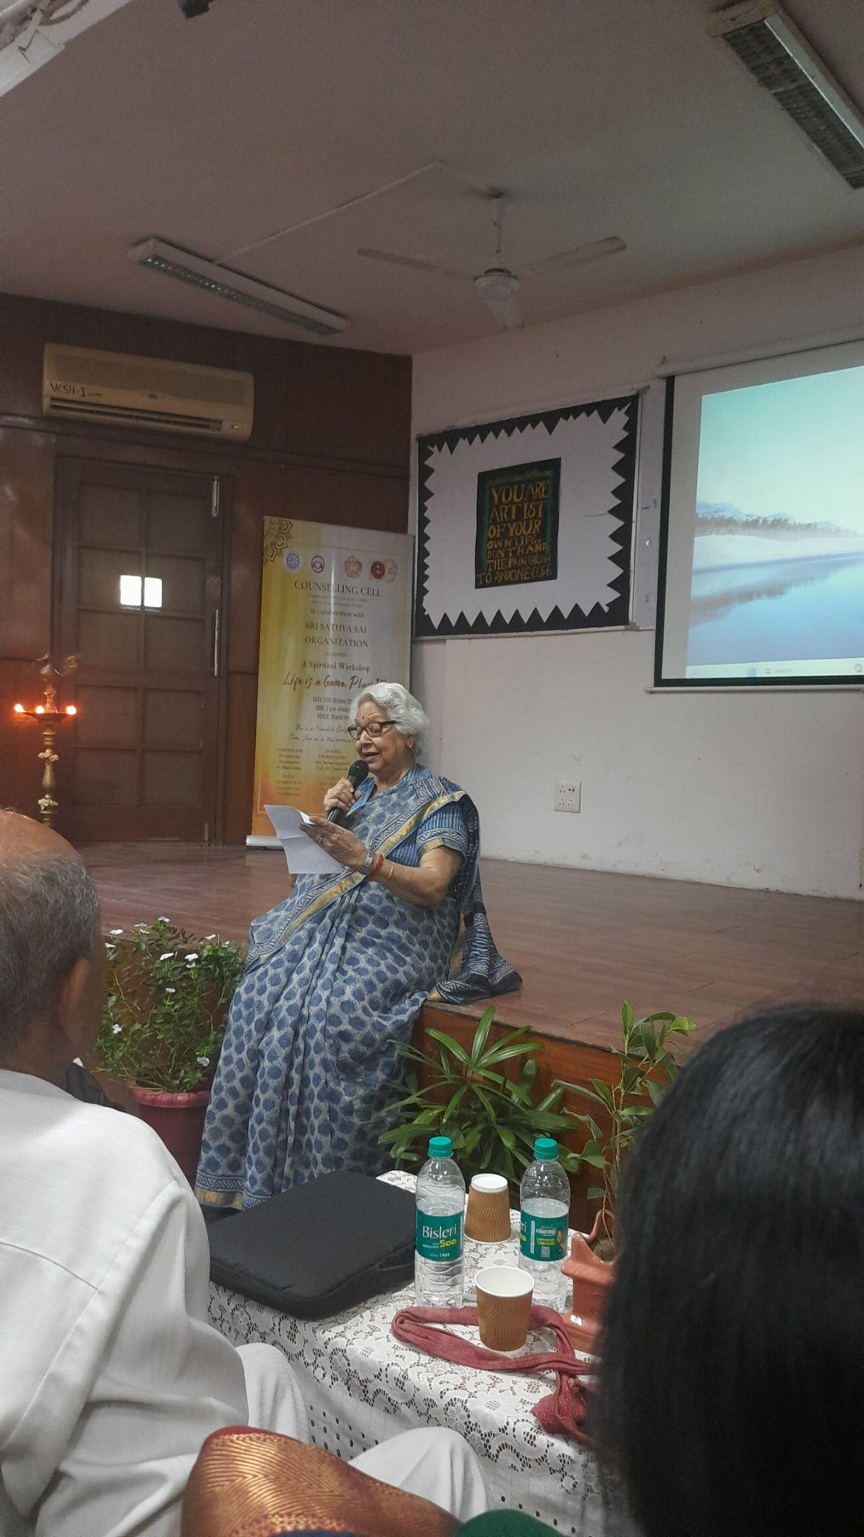
Life is a Game, Play It!
Spiritual Workshop
11th October 2023- January 2024
Counselling cell collaborated with Sri Sathya Sai Seva Organisation to conduct this unique program, designed specially for young people, by young people
The objective of the program was to introduce ideas of holistic personality development and living a balanced life, while training the students on leadership, stress management and time management skills.
The program consists of 7 modules which took place over 4 months.

Slide 30
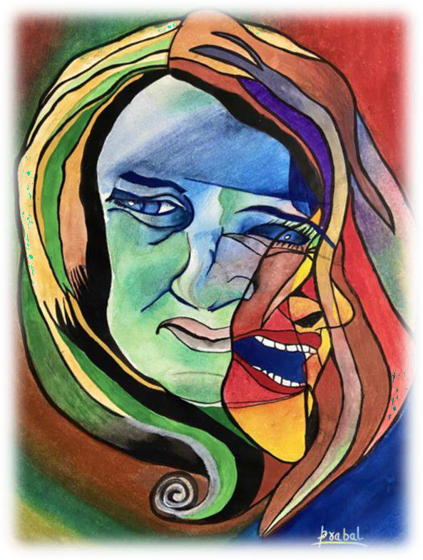

Slide 31
ALUMNI
This is one of the initiatives of the Counseling Cell of Vivekananda College aimed at providing emotional and psychological support to the (former) students of Vivekananda College.
This vision reflects the institution’s eternal
commitment towards the welfare of its students.

Slide 32
Activities
The "Stress Relieving Activities Initiative" is a program designed to support students in managing their stress and promoting overall well-being.
The initiative focuses on organizing a different stress-relieving activity each week, aiming to provide students with various tools and techniques to cope with the challenges of academic and personal life.

Slide 33
Mirroring Technique
Mirroring activity is a technique most commonly used in Expressive Arts Therapies.
It involves mirroring the movements of the person in
front of you.
The activity can be used for a variety of purposes, for example, it is quite often used for building empathy in relationships.

Slide 36
Introducing a Certificate Course on Counseling Skills
Encouraging more and more people through various talks, webinars, and workshops to come forward if they are in a need of help
We will continue to:
-provide a supportive environment for the students and the faculty alike,
-offer a confidential and a non-judgmental space to confide in
-help students to attain their personal and professional goals

Slide 37
’
“Self-care activity was a nice activity as we came to know about the new ways of self-care in all of the domains.”
“Autism awareness activity was a nice awareness activity as we came to know about autism and how to identify these kids.”
“Self-talk activity was a nice activity as I had to accept my fears along with the beauty of life.”

Slide 38
LET ´S TOGETHER MAKE THIS WORLD A BETTER PLACE!

